Slide 1
PROBABILITY

Slide 2
SET
(Well defined list or collection of items)
TYPE OF SETS
Equal : All the elements are same
Null : Null or Empty set with no element.
Subset : If every element of set B is also an element of set A, the B is called as a subset of A.
Universal : All sets are a subset of a particular set. This set is called universal set denoted by U or S.
OPERATION ON SETS
Union: The union of the sets A and B is the set of elements belongs to A or to B or both A and B. Denoted by AUB (A union B)
Intersection: The intersection of the two sets A and B is the set of elements that are common to both A and B. Denoted by A∩B (A intersection B)
Difference: The difference of two sets A and B is A – B (A minus B)
Complement: If A is a subset of universal set S then difference of S and A (S-A) called complement of A (A’)
These terms will them lead to Random experiment, outcomes, sample space, event etc.

Slide 3


Event Relations
The beauty of using events, rather than simple events, is that we can combine events to make other events using logical operations: and, or and not.
The union of two events, A and B, is the event that either A or B or both occur when the experiment is performed. We write
A ∪ B
S
A
B

Slide 4

Event Relations
The intersection of two events, A and B, is the event that both A and B occur when the experiment is performed. We write A ∩ B.
S
A
B
If two events A and B are mutually exclusive, then P(A ∩ B) = 0.

Slide 5
Event Relations
The complement of an event A consists of all outcomes of the experiment that do not result in event A. We write A^{C}.
S
A^{C}
A

Slide 6

Example
Select a student from the classroom and
record his/her hair color and gender.
  A: student has brown hair
  B: student is female
  C: student is male
Mutually exclusive; B = C^{C}
What is the relationship between events B and C?
A^{C}:
B∩C:
B∪C:
Student does not have brown hair
Student is both male and female = ∅
Student is either male and female = all students = S

Slide 7
Calculating Probabilities for Unions and Complements
There are special rules that will allow you to calculate probabilities for composite events.
The Additive Rule for Unions:
For any two events, A and B, the probability of their union, P(A ∪ B), is
A
B

Slide 8
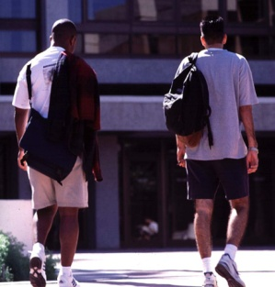
Example: Additive Rule
Example: Suppose that there were 120 students in the classroom, and that they could be classified as follows:
A: brown hair
P(A) = 50/120
B: female
P(B) = 60/120
 | Brown | Not Brown
Male | 20 | 40
Female | 30 | 30
P(A∪B) = P(A) + P(B) – P(A∩B)
= 50/120 + 60/120 - 30/120
= 80/120 = 2/3
Check: P(A∪B)
= (20 + 30 + 30)/120

Slide 9
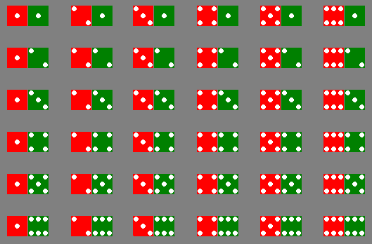
Example: Two Dice
A: red die show 1
B: green die show 1
P(A∪B) = P(A) + P(B) – P(A∩B)
= 6/36 + 6/36 – 1/36
= 11/36

Slide 10

A Special Case
When two events A and B are mutually exclusive, P(A∩B) = 0
and P(A∪B) = P(A) + P(B).
A: male with brown hair
P(A) = 20/120
B: female with brown hair
P(B) = 30/120
 | Brown | Not Brown
Male | 20 | 40
Female | 30 | 30
P(A∪B) = P(A) + P(B)
= 20/120 + 30/120
= 50/120
A and B are mutually exclusive, so that

Slide 11
Example: Two Dice
A: dice add to 3
B: dice add to 6
P(A∪B) = P(A) + P(B)
= 2/36 + 5/36
= 7/36
A and B are mutually exclusive, so that

Slide 12
Calculating Probabilities for Complements
A^{C}
A
We know that for any event A:
  P(A ∩ A^{C}) = 0
Since either A or A^{C} must occur,
  P(A ∪ A^{C}) =1
so that P(A ∪ A^{C}) = P(A)+ P(A^{C}) = 1
P(A^{C}) = 1 – P(A)

Slide 13

Example
Select a student at random from the classroom. Define:
A: male
P(A) = 60/120
B: female
P(B) = ?
 | Brown | Not Brown
Male | 20 | 40
Female | 30 | 30
A and B are complementary, so that
P(B) = 1- P(A)
= 1- 60/120 = 60/120

Slide 14
Calculating Probabilities for Intersections
In the previous example, we found P(A ∩ B) directly from the table. Sometimes this is impractical or impossible. The rule for calculating P(A ∩ B) depends on the idea of independent and dependent events.
Two events, A and B, are said to be independent if the occurrence or nonoccurrence of one of the events does not change the probability of the occurrence of the other event.

Slide 15
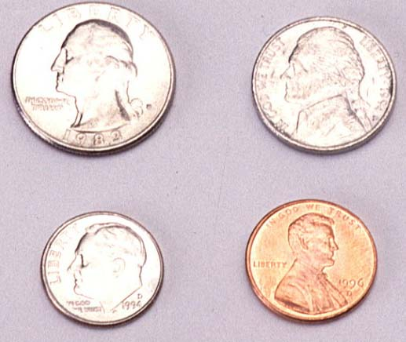
Example 1
Toss a fair coin twice. Define
  A: head on second toss
  B: head on first toss
P(A|B) = ½
P(A|not B) = ½
HH
1/4
1/4
1/4
1/4
HT
P(A) does not change, whether B happens or not…
A and B are independent!
TH
TT

Slide 16
Example 2
A bowl contains five Marbles, two red and three blue. Randomly select two, and define
  A: second is red.
  B: first is blue.
m
P(A|B) =P(2nd red|1st blue)= 2/4 = 1/2
P(A|not B) = P(2nd red|1st red) = 1/4
m
m
m
m
P(A) does change, depending on whether B happens or not…
A and B are dependent!

Slide 17
Example 3: Two Dice
Toss a pair of fair dice. Define
  A: red die show 1
  B: green die show 1
P(A|B) = P(A and B)/P(B)
=1/36/1/6=1/6=P(A)
P(A) does not change, whether B happens or not…
A and B are independent!

Slide 18
Example 3: Two Dice
Toss a pair of fair dice. Define
  A: add to 3
  B: add to 6
P(A|B) = P(A and B)/P(B)
=0/36/5/6=0
P(A) does change when B happens
A and B are dependent! In fact, when B happens, A can’t

Slide 19
Defining Independence
We can redefine independence in terms of conditional probabilities:
Two events A and B are independent if and only if
P(A|B) = P(A) or P(B|A) = P(B)
Otherwise, they are dependent.
Once you’ve decided whether or not two events are independent, you can use the following rule to calculate their intersection.

Slide 20
The Multiplicative Rule for Intersections
For any two events, A and B, the probability that both A and B occur is
P(A ∩ B) = P(A) P(B given that A occurred) = P(A)P(B|A)
If the events A and B are independent, then the probability that both A and B occur is
P(A ∩ B) = P(A) P(B)

Slide 21
Key Concepts
I. Experiments and the Sample Space
1. Experiments, events, mutually exclusive events,
simple events
2. The sample space
II. Probabilities
1. Relative frequency definition of probability
2. Properties of probabilities
a. Each probability lies between 0 and 1.
b. Sum of all simple-event probabilities equals 1.
3. P(A), the sum of the probabilities for all simple events in A

Slide 22
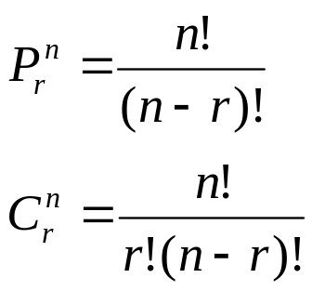
Key Concepts
III. Counting Rules
1. mn Rule; extended mn Rule
2. Permutations:
3. Combinations:
IV. Event Relations
1. Unions and intersections
2. Events
a. Disjoint or mutually exclusive: P(A ∩ B) = 0
b. Complementary: P(A) = 1 − P(A^{C} )

Slide 23
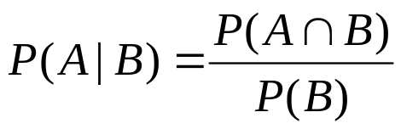

Key Concepts
3. Conditional probability:
4. Independent and dependent events
5. Additive Rule of Probability:
6. Multiplicative Rule of Probability:
7. Law of Total Probability
8. Bayes’ Rule

